Slide 1
DIVERSITY
Shape the world with poems…

Slide 2
VR is the ultimate technology to express yourself

Slide 3
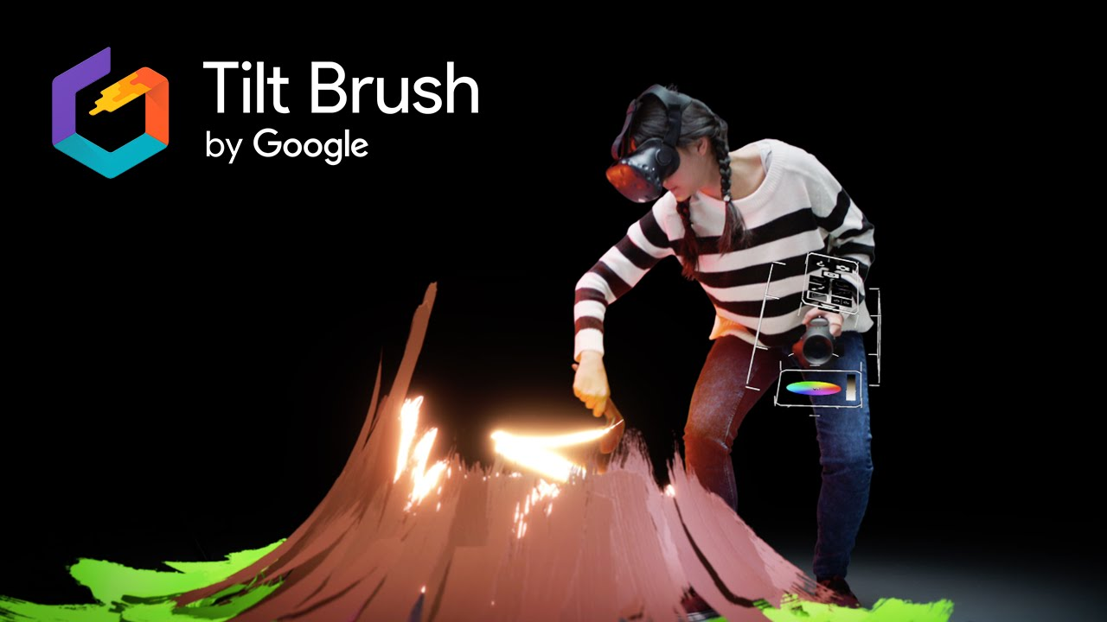
From Volcanos…

Slide 4
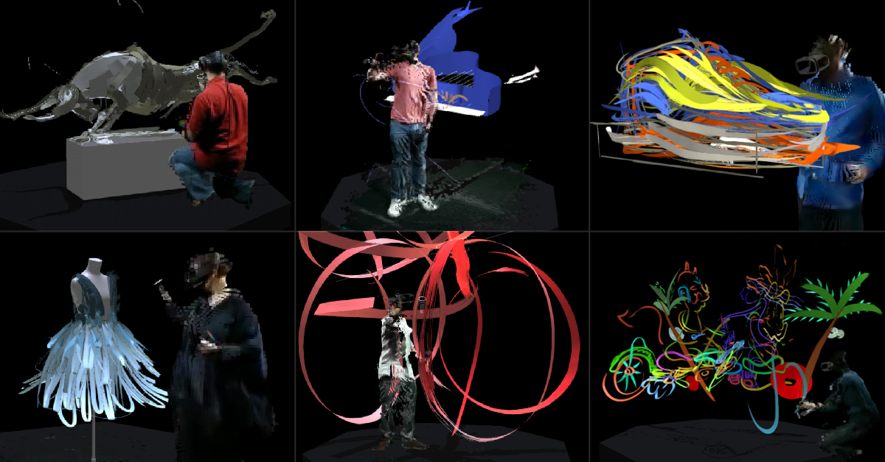
To design - abstract…

Slide 5

But, What about the rest?

Slide 6
VRGen is a VR experience witch 3D model your verbal expressions.

Slide 7
How its work…

Slide 8
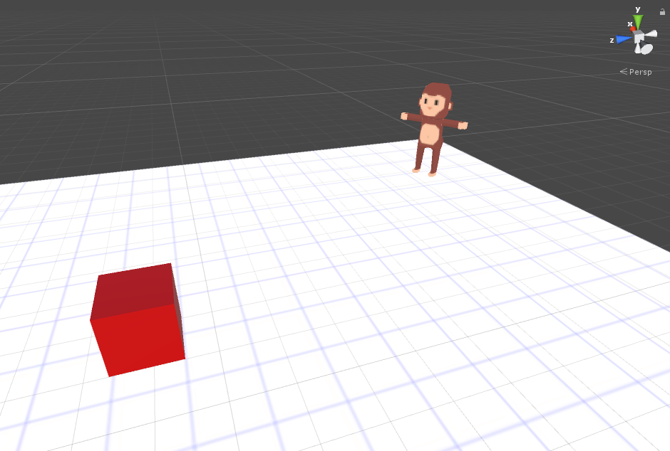
You say something….
Recommend system
Ai
Capture your voice…
Microsoft Cognitive system…
Return a text
Vr
Ai
Natural Language
Processing

